Slide 1

Navigating Global Issues: An Interactive Approach to Assessing General Education Outcomes
Presented by:
Courtney Shull, Associate Dean
with special guest Christina Clarke, Assistant Dean

Slide 2
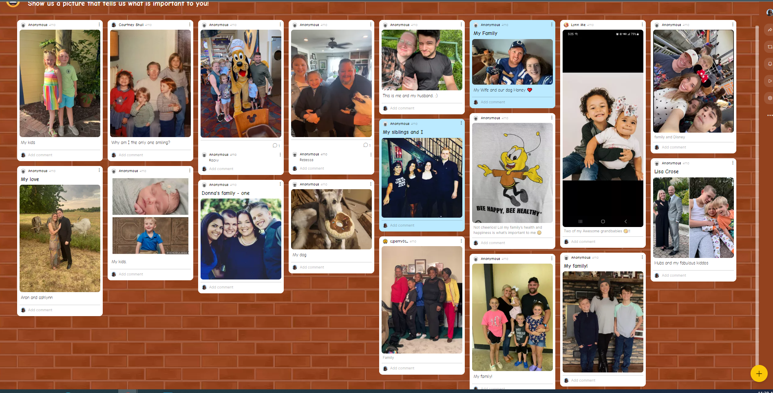
Class begins with “Show us what is important to you”
(Option Padlet.com)

Slide 3

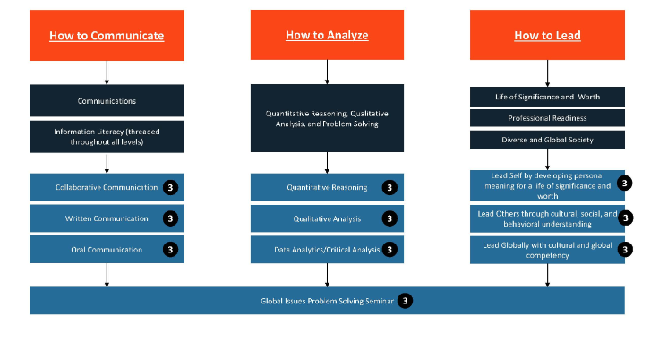
General Education Model: A Mission Alignment

Slide 4
Global Issues Seminar Course Model
What is a Global Issue
Effective Groups / Collaborative Learning
Analyzing Scholarly Literature
Global Issue Solutions
Cultural Competency and Ethics
Scaffolded Assessment
Professor as a Coach Module
6 Modules – 6 Weeks – All Online

Slide 5
Learning Tools: Weekly 1 Hour Tech Live Engagement Session
Interactive Quiz/Slide/Resource (Kahoot)
Padlet
Polling
Break Outs
Collaborative Teams

Slide 6
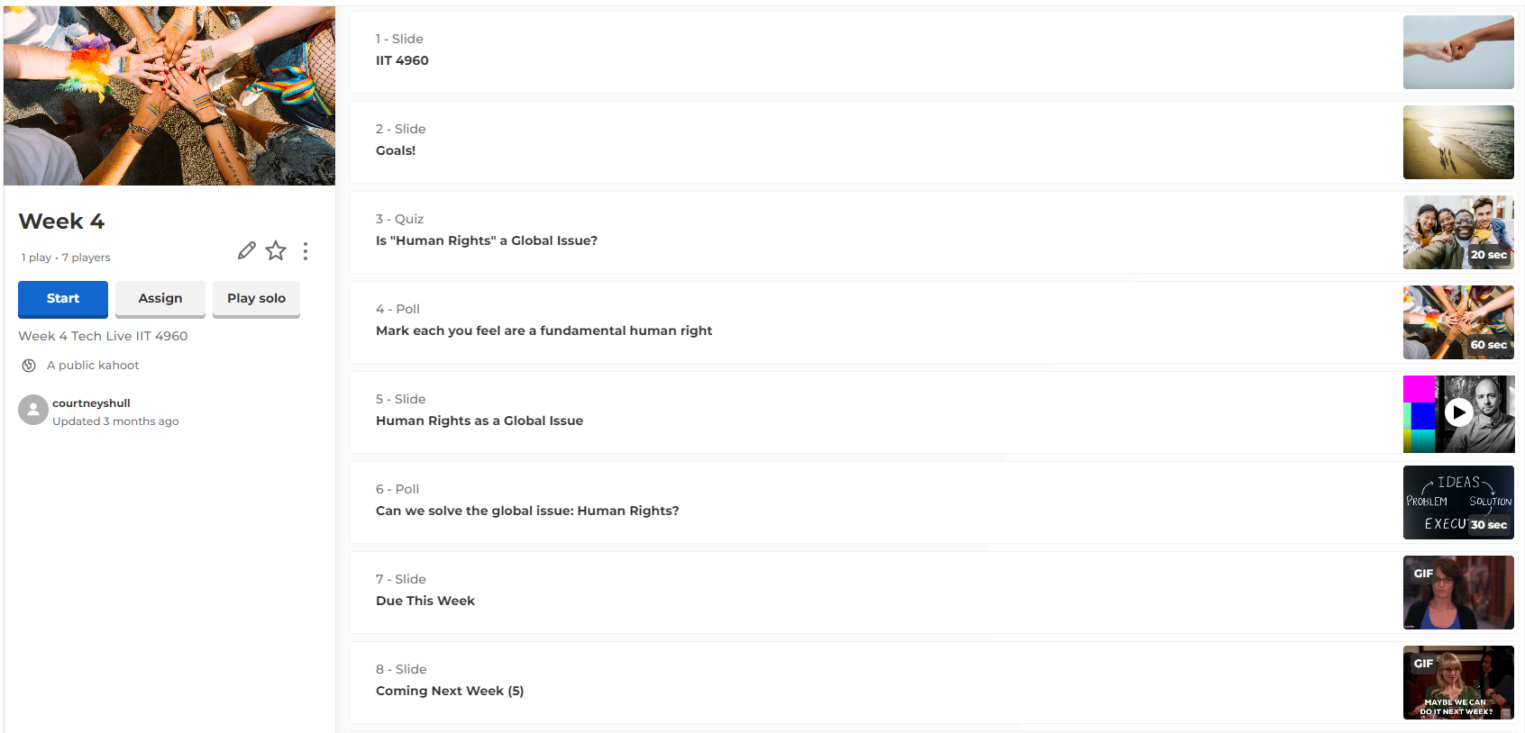
Kahoot Interactive
Notes:
https://create.kahoot.it/share/week-4/b9de177d-039c-4608-a429-9c1c97c0beb2

Slide 7

Collaborative Activity
Demonstration of group work model

Slide 8

Success Results
Course has run x3
N= 67
How to Communicate: 52 Met
How to Analyze: 55 Met
How to Lead: 57 Met
Analysis: 2 Students from each section did not submit final project. Areas to consider for action plans: Course timing, sequencing, transfer numbers, online versus traditional performance, writing across the curriculum

Slide 9

Lessons Learned

Slide 10

Thank you!
Presenter: Courtney Shull, Associate Dean CCShull@indianatech.edu
Special Guest Star: Christina Clarke, Assistant Dean CLClarke@indianatech.edu

